Slide 1

The University of Mississippi
NSF EPSCoR RII Track-4
EPSCoR Fellows
ORSP Information Sessions
December 2019, January 2020
Dec 10, 3pM: Weir 107
Dec 12, 11 am: Weir 107
Dec 16, noon: Weir 107
Jan 3, 10 am: Weir 107
Notes:
Jason Hale to Start

Slide 2
Brief Introductions
  Attendees:
    Name, Title, and Department
    First NSF Track-4 Proposal?
    Any prior NSF proposal experience/success?
Notes:
JASON HALE

Slide 3
Key Points
Spend extended periods of time at research premier research facilities
Far enough away that temporary relocation is necessary
Have a major impact on career trajectory
Up to 6 months total over 2 years

Slide 4
Host Site
Host sites for fellowship projects must be located within the United States, its territories, or possessions.
Host sites may be:
  a government laboratory
  a Federally Funded Research and Development Center (FFRDC)
  a commercial or non-profit research center, or
  an academic institution.
Host site for UM fellows should probably NOT be in Miss.
  But, if at least 4 hours drive away, then maybe (e.g., Gulf Coast)
  Is there any precedent for providing awards for same-jurisdiction fellowships? If so, demonstrate that in your internal pre-proposal.

Slide 5
Eligibility
Solicitation I.B (page 4)
Mississippi is an EPSCoR state
Non-tenured faculty (at time of submission)
“PIs employed by degree-granting institutions of higher education must hold a non-tenured faculty appointment.”
“This may be in the form of a pre-tenure tenure-track position or a long-term non-tenure-track position.”
Persons holding non-faculty research staff positions or transitional (< 3 years) fixed-term postdoctoral appointments are not eligible.”

Slide 6
Eligibility
Persons who hold non-tenured faculty positions at institutions of higher education within EPSCoR jurisdictions may participate in RII Track-4. It is anticipated that most proposals will be submitted by PIs who hold tenure-track appointments but have not yet received tenure as of the proposal deadline date. However, faculty members at degree-granting institutions who hold long-term positions outside of the tenure track are also explicitly eligible for consideration, regardless of their position title or rank. ...persons who hold transitional (less than three years) fixed-term postdoctoral appointments are not eligible to apply, even if their organizations classify such appointments as ‘faculty’ for administrative purposes.
In all cases, the required Letter of Support from the PI’s supervisory administrator should verify the PI’s eligibility relative to these criteria. Questions regarding PI eligibility for RII Track-4 should be directed toward the cognizant Program Officers listed above.

Slide 7
Eligible Expenses
$300k Max Budget
  Including Direct and Indirect Costs
  But most projects won’t come close to this!
Up to 6 months salary plus fringes for the PI and one additional trainee-level researcher
  (typically a graduate student or postdoctoral fellow);
expenses (up to $75K) for PI &1 trainee-level researcher:
  To travel to the host site (up to $20,000 total for both)
  Living expenses at host site (up to $50,000 total for both)
  Other related travel (up to $5,000 for both)
Up to $10K in other direct costs related to host site activities:
  supplies, shipping equipment, publication costs, facility use fees, etc.
Indirect costs calculated on Modified Total Direct Costs
  (UM’s off-campus rate for research projects applies: 26%)
No sub-awards allowed

Slide 8
Standard NSF Review Criteria
Merit criteria: Potential to advance, if not transform, the frontiers of knowledge; assessment based on appropriate metrics
Broader Impact: potential to benefit society and contribute to the achievement of specific, desired societal outcomes.
Review elements:
  1. What is the potential for the proposed activity to: a. advance knowledge b. benefit society
  2. To what extent do the proposed activities suggest and explore creative, original, or potentially transformative concepts?
  3. Is the plan for carrying out the proposed activities well-reasoned, with a mechanism to assess success?
  4. How well qualified is the PI and team?
  5. Are there adequate resources available to the PI?

Slide 9
Special NSF Criteria for Track-4
Evidence of outcomes achievability, in fellowship timeframe at host site
Likely impact on faculty’s research career trajectory
  during award and long out-lasting post-award
Tangible benefits to the home institution/jurisdiction
  Beyond just to the PI
Home and Host resources availability and commitment for project success

Slide 10
Merit and Broader Impacts
  Intellectual Merit
  describe the project's research-focused activities
  how these activities will enhance the PI's individual research capacity beyond the duration of the fellowship period
  Broader Impacts
  Minimum:
    Benefits to home institution and jurisdiction (Mississippi)
  Additional:
    Any other benefits under NSF’s Broader Impacts umbrella
      (See next slide)
Notes:
JASON HALE

Slide 11
Broader Impacts (general NSF)
Broader impacts may be accomplished through the research itself, through the activities that are directly related to specific research projects, or through activities that are supported by, but are complementary to, the project. NSF values the advancement of scientific knowledge and activities that contribute to achievement of societally relevant outcomes.
Such outcomes include, but are not limited to: full participation of women, persons with disabilities, and underrepresented minorities in science, technology, engineering, and mathematics (STEM); improved STEM education and educator development at any level; increased public scientific literacy and public engagement with science and technology; improved well-being of individuals in society; development of a diverse, globally competitive STEM workforce; increased partnerships between academia, industry, and others; improved national security; increased economic competitiveness of the United States; and enhanced infrastructure for research and education.

Slide 12
UM Track 4 Past Winners!
  4 UM Faculty Members have been awarded NSF CAREER grants
    Out of 9 applications submitted in three years
    44% success rate!
    2017: Ryan Garrick, Biology, to Ohio State University
    2017: Sasa Kocic, Mathematics, to UC Irvine
    2019: Samuel Lisi, Mathematics, to Ohio State University
    2019: Brian Platt, Geology/Geo Engr., to Univ. of Minnesota
  https://news.olemiss.edu/two-um-faculty-win-inaugural-national-science-foundation-fellowships/
Notes:
JASON HALE

Slide 13
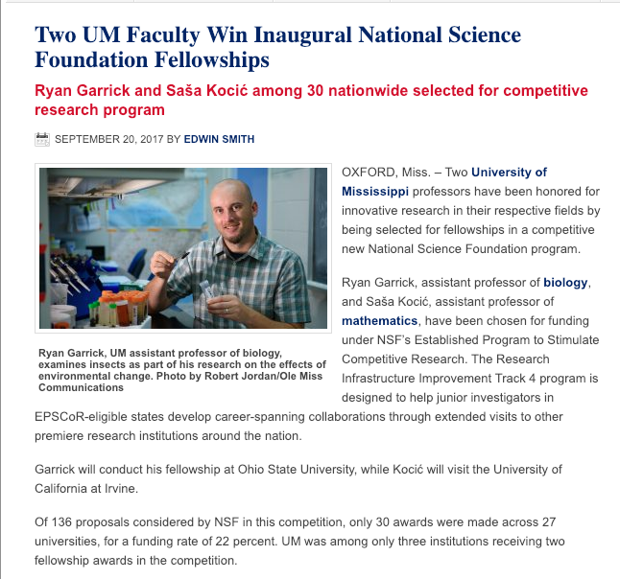
UM Track 4 Past Winners
Notes:
JASON HALE

Slide 14
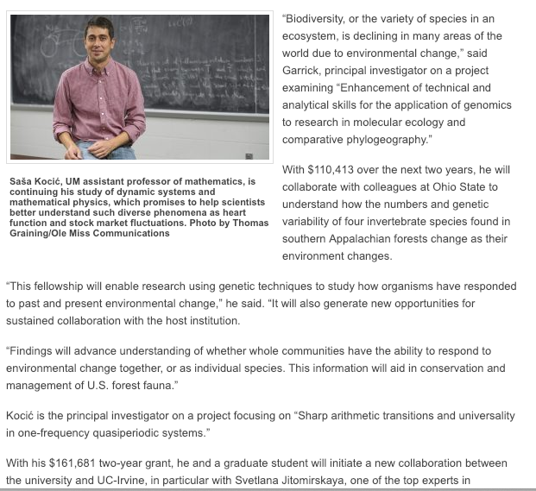
UM Track 4 Past Winners
Notes:
JASON HALE

Slide 15
ORSP UM Grant Mentors Program
  Proposer: Identify a potential UM Mentor for a funding opportunity
    UM faculty member with recent success in extramural funding competitions
    ORSP can assist in identifying/vetting mentors
  Mentor and Proposer: Agree to work together on the proposal
    Complete a Mentor Agreement Form
    Obtain sign-off from Chair and Dean of Mentor and Proposer
    Upload the signed form to the online transmittal (TSS)
  Develop and submit proposal
    Mentor receives $500 in extra pay for extra work (from Proposer’s dept./school)
    If proposal is funded, mentor receives $500 award pay from ORSP
http://research.olemiss.edu/GrantMentors
Notes:
JASON HALE

Slide 16
ORSP Enhanced Review
  A no-charge, non-technical review
    Provided in-house by ORSP Research Development
    Download request form http://research.olemiss.edu/EnhancedReview
  Timelines
    1-week turnaround time with advanced notice
    1-2 weeks advanced notice requested
    Upload the signed form to the online transmittal (TSS)
  Deliverables
    Margin Notes
    Suggested Edits (as tracked changes to MS Word doc draft)
    Summary of suggestions
Notes:
JASON HALE

Slide 17
ORSP Enhanced Review: Things Reviewed For
  Clarity, effect, and specificity
  Responsiveness to program guidelines and review criteria
  Grammar and punctuation
  Wording/effect
  Broader/societal impacts
  Reference to UM resources and infrastructure
Notes:
JASON HALE

Slide 18
T.I.G. External Disciplinary Expert Review
  Fee-based, technical review
  Reviewer is a consultant T.I.G. contracts with to provide review
  Reviewer has:
    Subject matter expertise and/or
    May have previous experience as a program director at a federal agency
  Provides suggestions for strengthening proposal, aimed at increasing competitiveness
  Cost to UM: $750 in most cases (with sufficient notice)
    ORSP will pay $250 of cost
    Remainder should come combination of:
      PI’s overhead account
      Chair and/or Dean contributions
Notes:
JASON HALE

Slide 19

T.I.G. External Disciplinary Expert Review
Notes:
JASON HALE

Slide 20
Key Dates, 2019 Competition
  12/14/2017 NSF solicitation released
  1/29/2019 PAPPG NSF 19-1 effective.
  1/07/2020 Non-binding NOIs due to ORSP
  1/21/2020 Internal Pre-Proposals due to ORSP
  1/21/2020 3 UM Pre-Proposals selected
  2/17/2020 Narrative to ORSP RD if requesting
  Enhanced Review service
  2/25/2020 Transmittal due to ORSP
  3/10/2020 Full proposal due to NSF
Notes:
JASON HALE

Slide 21
UM Internal Proposals
  Project Summary: 1-page NSF-style Project Summary, including working title.
  Abbreviated Project Description: (3-5 pages)
  Preliminary Collaborator Letter of Support
  does not have to be the final, complete letter that would be submitted with the proposal to NSF, but should make it clear to UM internal reviewers that the collaborator is willing to host the PI at their institution
Notes:
JASON HALE

Slide 22
UM Internal Proposals
  Letter of Support from Administrative Supervisor of PI (e.g., Department Chair).
  Should make it clear that the supervisor thinks the fellowship will only help, and not in anyway hurt, the PI’s career trajectory, and that, if selected, the PI would be allowed to conduct the fellowship during the time indicated. Should also confirm the nature of the PI’s long-term appointment, if not in a tenure-track position.
  NSF-Style Biographical Sketch
  Should be compliant and largely complete.
Notes:
JASON HALE

Slide 23
Non-binding Internal NOI
  Non-binding NOIs should include the applicant name, appointment, department, administrative supervisor name, tentative project title & host location, and keywords.
Notes:
JASON HALE

Slide 24
Project Description
  The goals and objectives for the fellowship project should be clearly stated, and the research plan for achieving the goals and objectives should be presented in sufficient detail to allow reviewers to judge the proposal fairly. The project description should specify the expected outcomes from the fellowship, and should include a timeline for meeting the project goals and objectives. It is crucial that the project description explain clearly how the PI will specifically benefit from the unique opportunities provided by the RII Track-4 fellowship. It should also detail both the role of the host site in achieving the research goals and objectives and how the benefits to the PI’s research career will be sustained beyond the award period.
Notes:
JASON HALE

Slide 25
UM Internal Review Criteria
  Intellectual Merit
  Broader Impacts
  Clarity of Writing
  Specificity
    Including Assessment
  Strength of Proposed Partnership
    Obvious benefit? Clear host support of idea?
  Sufficiency of Letter from Administrative Supervisor
Notes:
JASON HALE

Slide 26
Non-Duplicative Effort
  EPSCoR support of a RII Track-4 activity should not duplicate support from any other available federal, jurisdictional, or institutional resources.
  The support should contribute to both the PI’s research capacity and to the improvement of their institution’s scientific competitiveness more broadly.
Notes:
JASON HALE

Slide 27
Questions/Discussion
Notes:
JASON HALE

